Slide 1

Deloitte Pre Hire Training 2017
FOUNDATION TRAINING
ORM With Hibernate

Slide 2
ORM with Hibernate 3.5
Object State and Transaction

Slide 3
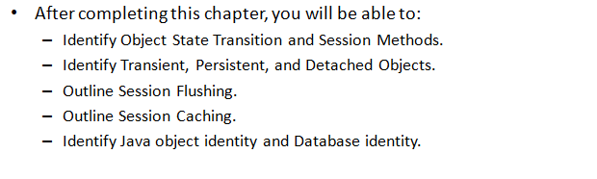
Objectives

Slide 4
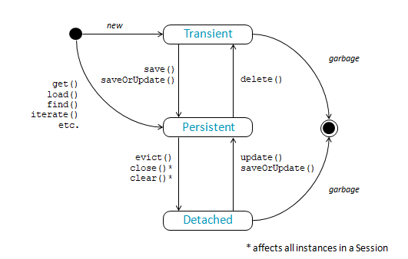
Object State and Session Methods

Slide 5
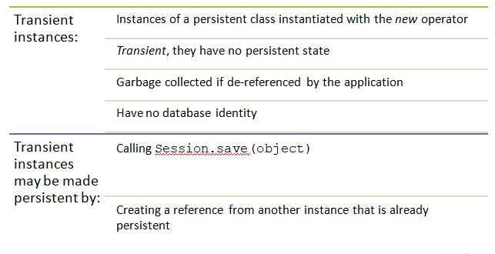
Transient Object

Slide 6
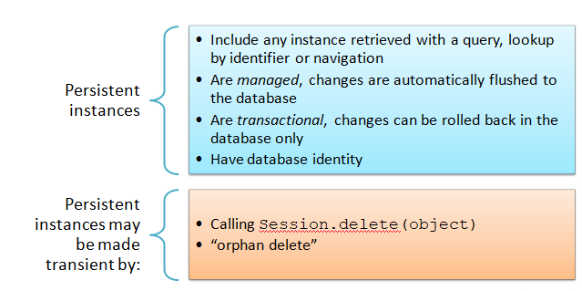
Persistent Object

Slide 7
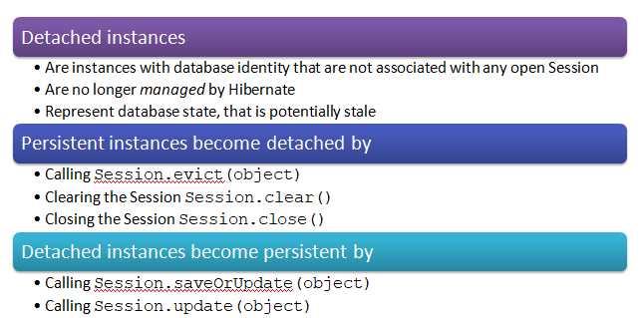
Detached Objects

Slide 8
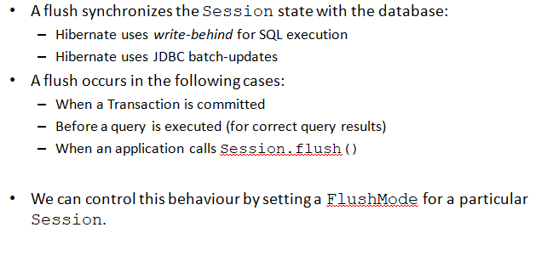
Session Flushing and Closing

Slide 9
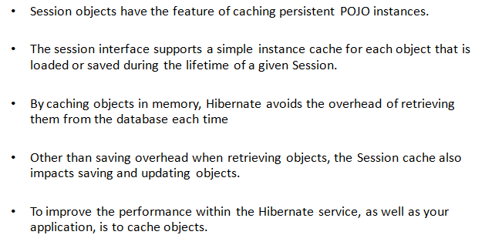
Session Caching

Slide 10
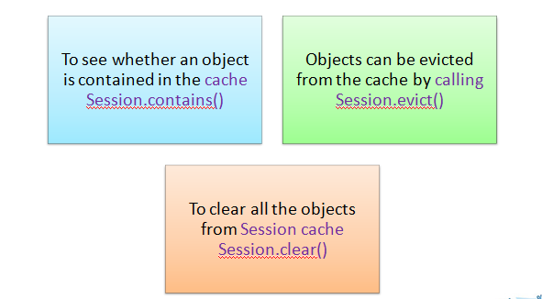
Session Cache Management

Slide 11
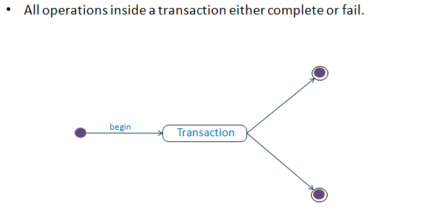
Transactions

Slide 12
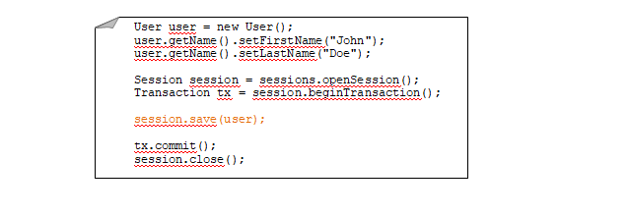
Transactions
Hibernate executes SQL only as necessary, in this case, when the Transaction is committed.
Hibernate uses transaction-scope write-behind strategy.

Slide 13
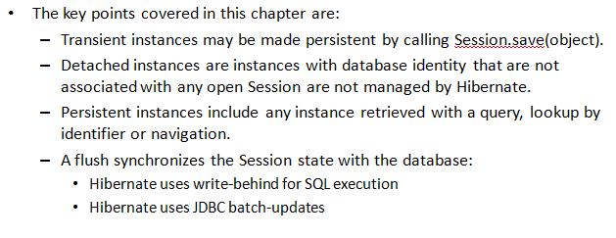
Summary

